Slide 1

Human Activity Recognition with Smartphones
Matt Xu

Slide 2
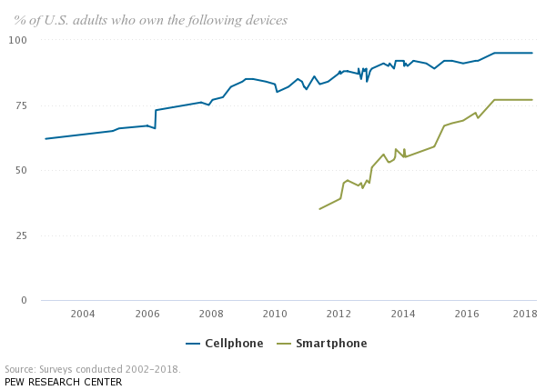
The Motivation
Competence in learning profound high-level knowledge about human activity from raw sensor inputs.
Wide applications in medical research and human survey system.
Growing popularity and computational power of smartphone make it an ideal candidate for non-intrusive body-attached sensors.

Slide 3

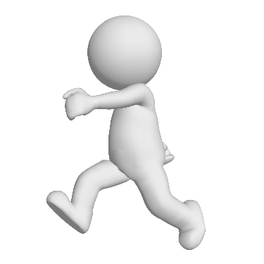

The Experiments
Group of 30 volunteers within an age bracket of 19-48
Each person performed six activities (laying, standing, sitting, walking, walking upstairs and walking downstairs) wearing a smartphone (Samsung Galaxy S II) on the waist.
Embedded accelerometer and gyroscope recorded triaxial acceleration and triaxial angular velocity at a constant rate of 50Hz. The experiments have been video-recorded to label the data manually.
Smartlab - Non-Linear Complex Systems Laboratory DITEN - Università degli Studi di Genova, Genoa (I-16145), Italy.
CETpD - Technical Research Centre for Dependency Care and Autonomous Living Universitat Politècnica de Catalunya (BarcelonaTech). Vilanova i la Geltrú (08800), Spain

Slide 4
The Dataset
From UCI Machine Learning Repository
Triaxial acceleration from the accelerometer (total acceleration) and the estimated body acceleration.
Triaxial angular velocity from the gyroscope.
A 561-feature vector with time and frequency domain variables.
Its activity label (WALKING, WALKING_UPSTAIRS, WALKING_DOWNSTAIRS, SITTING, STANDING, LAYING)
An identifier of the subject who carried out the experiment (1-30).
70% participants in training dataset, 30% in testing dataset
Signals were pre-processed by applying noise filters
Features are normalized and bounded within [-1,1]
https://archive.ics.uci.edu/ml/datasets/human+activity+recognition+using+smartphones

Slide 5
Research Questions
Can we recognize human activity based on sensor data?
Can we identify different participants based on their movement style?

Slide 6
Exploratory Data Analysis: The features
fBodyAcc | 79
fBodyGyro | 79
fBodyAccJerk | 79
tGravityAcc | 40
tBodyAcc | 40
tBodyGyroJerk | 40
tBodyGyro | 40
tBodyAccJerk | 40
tBodyAccMag | 13
tGravityAccMag | 13
tBodyAccJerkMag | 13
tBodyGyroMag | 13
tBodyGyroJerkMag | 13
fBodyAccMag | 13
fBodyBodyAccJerkMag | 13
fBodyBodyGyroMag | 13
fBodyBodyGyroJerkMag | 13
angle | 7
subject | 1
Activity | 1
Data | 1

Slide 7
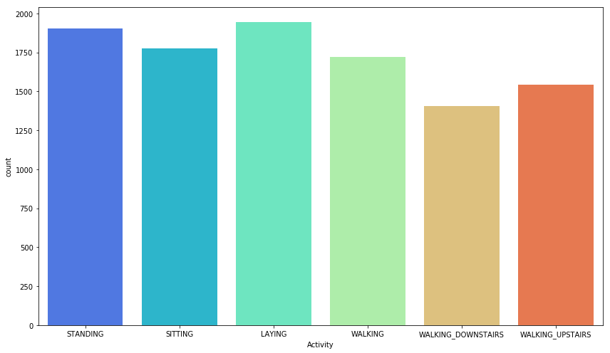
Exploratory Data Analysis: Data balance

Slide 8
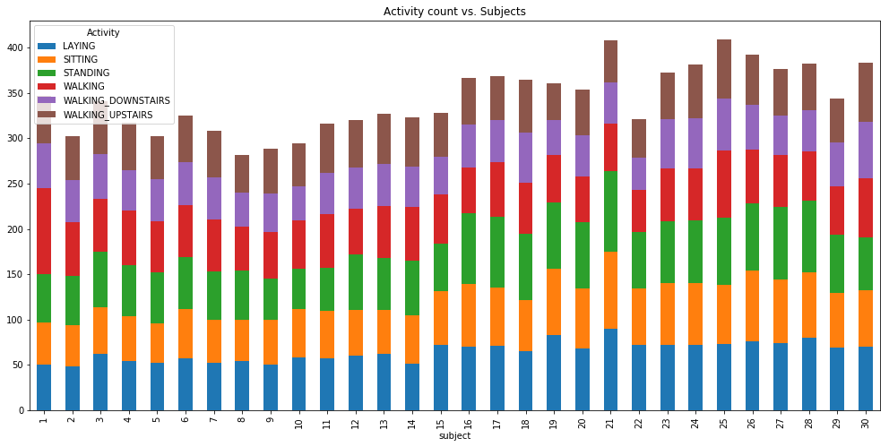
Exploratory Data Analysis: Data balance

Slide 9
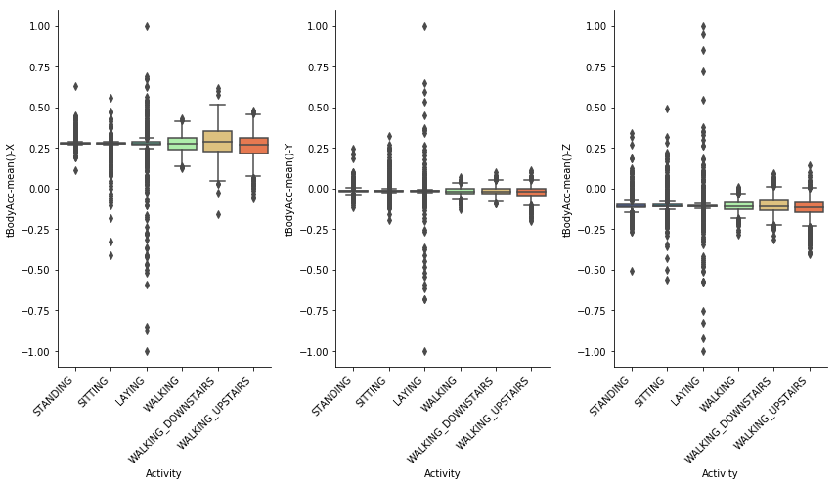
Exploratory Data Analysis: Acc data axial distribution
For all 30 participants

Slide 10
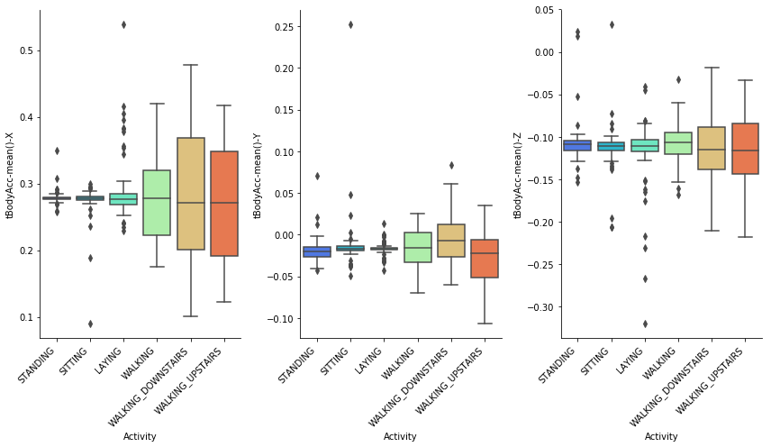
Exploratory Data Analysis: Acc data axial distribution
For participant #15

Slide 11
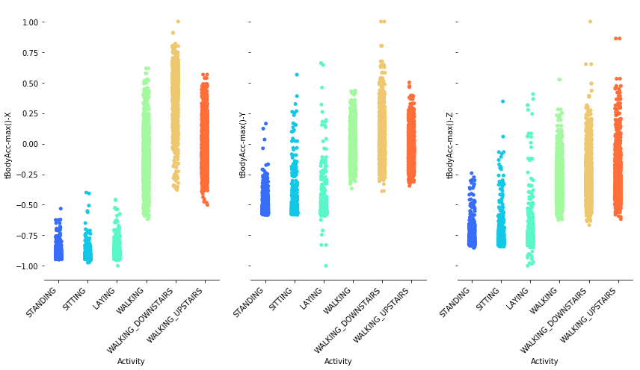
Exploratory Data Analysis: Max acc axial distribution
For all 30 participants

Slide 12
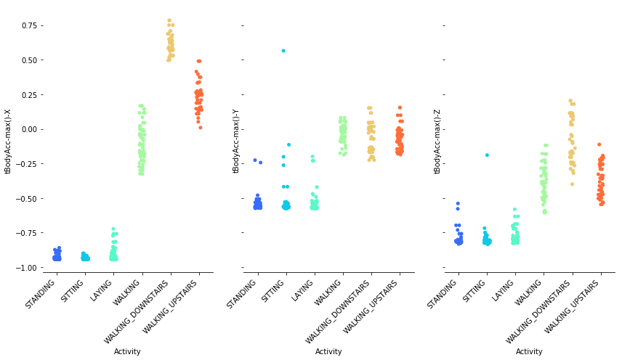
Exploratory Data Analysis: Max acc axial distribution
For participant #15

Slide 13
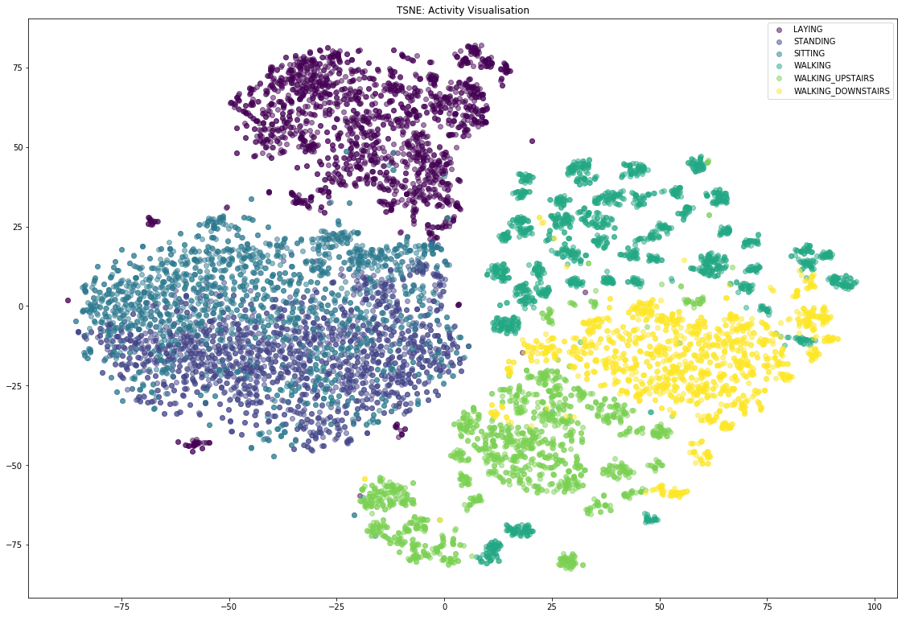
Exploratory Data Analysis: t-SNE visualization

Slide 14
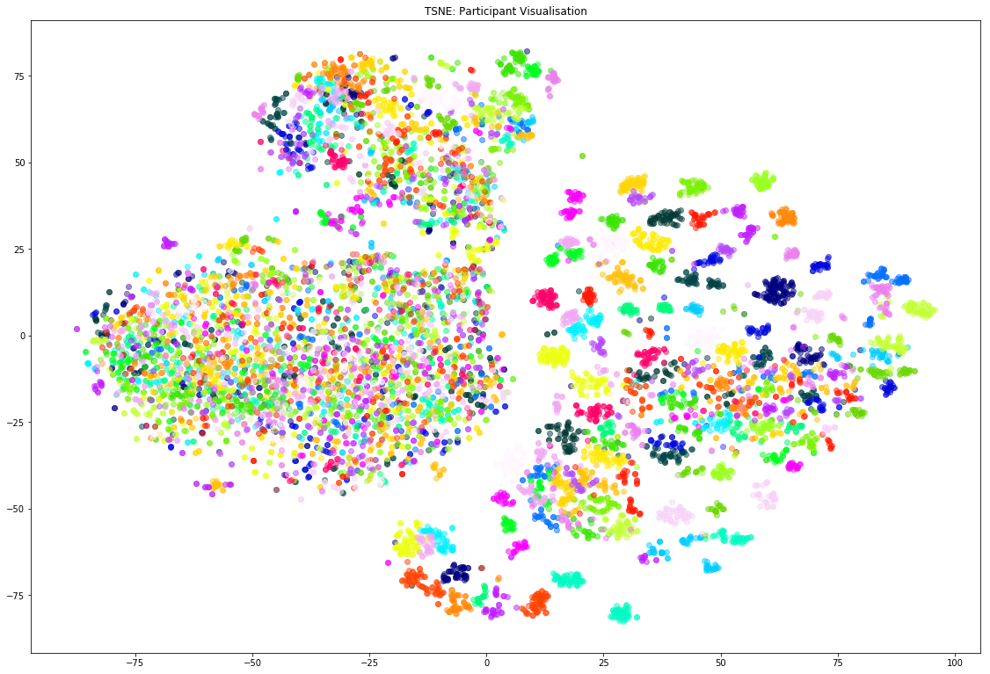
Exploratory Data Analysis: t-SNE visualization

Slide 15
Machine learning Data prep
Data types: all features are float, except ‘subject’ (int), and ‘Activity’ (Object)
Encode activities to:
0: LAYING, 1: SITTING, 2: STANDING, 3: WALKING,
4: WALKING_DOWNSTAIRS, 5: WALKING_UPSTAIRS
Combined train and test dataset and randomly split 70% for training and 30% for testing
Performed PCA to reduce to 120 features
Dataset shape:
X_train(7209, 120), X_test(3090, 120)

Slide 16
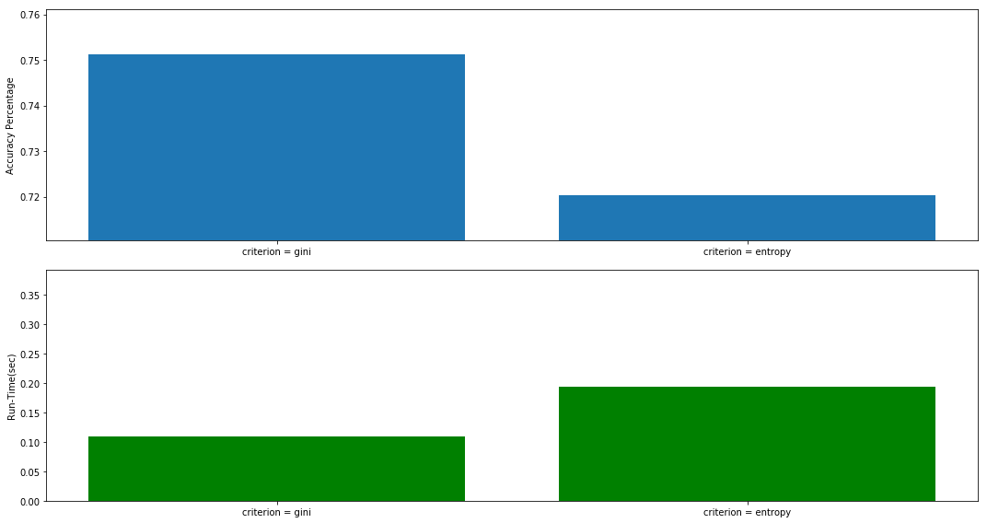
Machine learning Decision Trees (criterion)
75.1%
criterion=gini, entropy
max_features= sqrt(n)
LAY SIT STAND WALK W-DOWN W-UP
LAY
SIT
STAND
WALK
W-DOWN
W-UP
[[507 32 19 1 8 4]
[ 32 331 183 4 1 3]
[ 12 128 415 6 2 2]
[ 1 5 5 401 67 50]
[ 6 0 0 64 305 37]
[ 1 1 4 39 52 362]]
Confusion_matrix of
criterion = gini

Slide 17
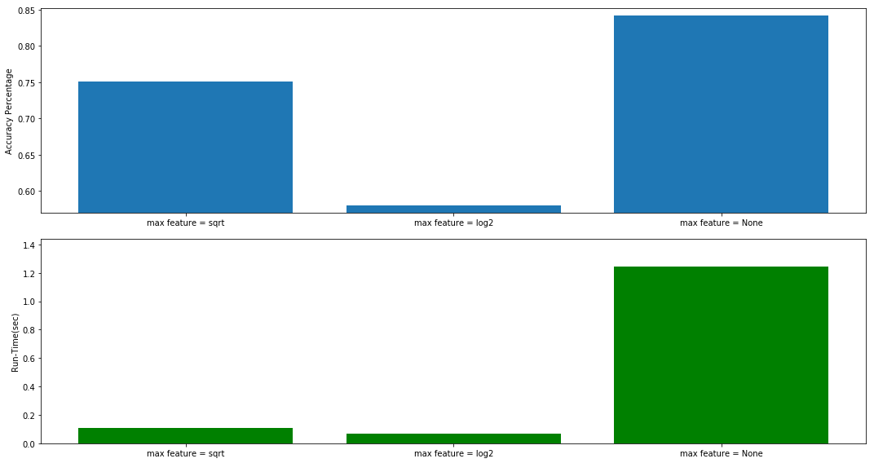
Machine learning Decision Trees (max_features)
84.2%
criterion=gini,
max_features=sqrt(n), log2, None
LAY SIT STAND WALK W-DOWN W-UP
LAY
SIT
STAND
WALK
W-DOWN
W-UP
[[550 12 7 1 1 0]
[ 13 395 146 0 0 0]
[ 0 117 448 0 0 0]
[ 0 0 0 481 30 18]
[ 1 0 0 29 331 51]
[ 1 1 0 24 36 397]]
Confusion_matrix of
max_features = none

Slide 18
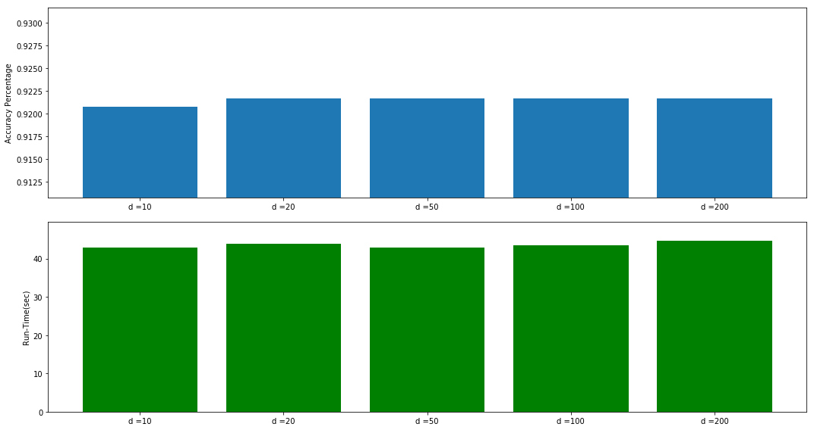
Machine learning Random Forest (max_depth)
92.2%
max_depth = 10, 20, 50, 100, 200
max_features= None
criterion=entropy
n_estimators = 50
LAY SIT STAND WALK W-DOWN W-UP
LAY
SIT
STAND
WALK
W-DOWN
W-UP
[[564 1 3 0 1 2]
[ 3 471 80 0 0 0]
[ 0 70 495 0 0 0]
[ 0 0 0 510 9 10]
[ 0 0 0 15 376 21]
[ 0 1 0 13 13 432]]
Confusion_matrix of
max_depth = 20

Slide 19
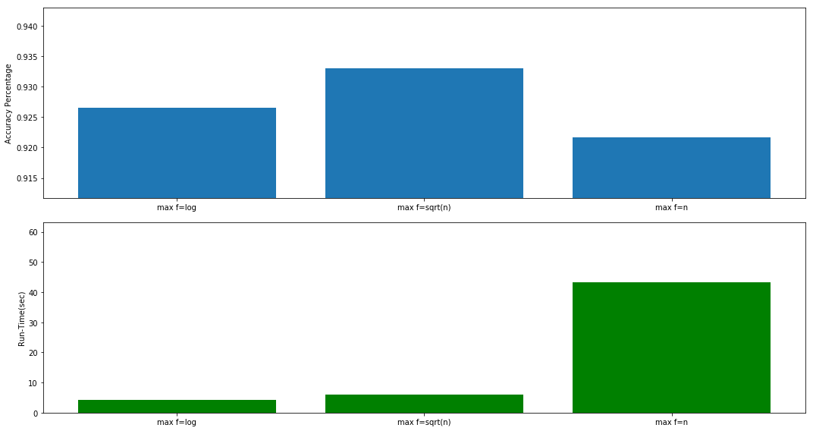
Machine learning Random Forest (max_features)
93.3%
max_depth = 20,
max_features= log2, sqrt(n), None
criterion=entropy
n_estimators = 50
LAY SIT STAND WALK W-DOWN W-UP
LAY
SIT
STAND
WALK
W-DOWN
W-UP
[[570 0 0 0 0 1]
[ 5 461 88 0 0 0]
[ 0 61 504 0 0 0]
[ 0 0 0 514 2 13]
[ 0 0 0 12 388 12]
[ 0 0 0 9 4 446]]
Confusion_matrix of
max_features = sqrt(n)

Slide 20
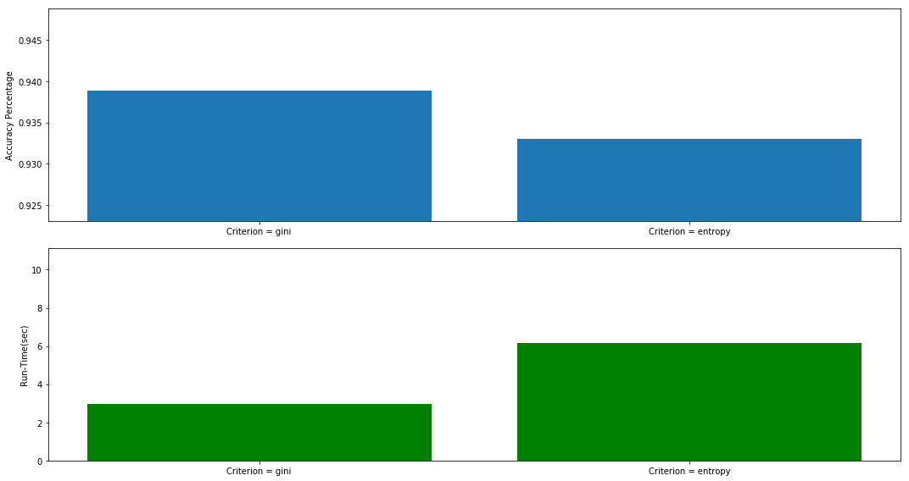
Machine learning Random Forest (criterion)
93.8%
max_depth = 20
max_features= sqrt(n)
criterion=entropy, gini
n_estimators = 50
LAY SIT STAND WALK W-DOWN W-UP
LAY
SIT
STAND
WALK
W-DOWN
W-UP
[[564 1 3 0 1 2]
[ 3 471 80 0 0 0]
[ 0 70 495 0 0 0]
[ 0 0 0 510 9 10]
[ 0 0 0 15 376 21]
[ 0 1 0 13 13 432]]
Confusion_matrix of
criterion = entropy

Slide 21
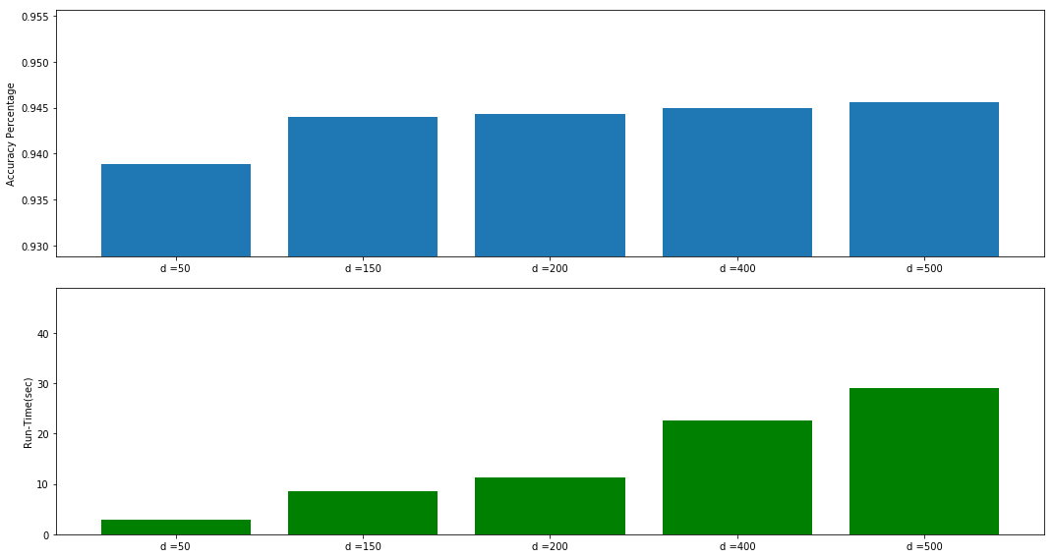
Machine learning Random Forest (n_estimators)
94.6%
max_depth = 20
max_features= sqrt(n)
criterion=gini
n_estimators = 50, 150, 200, 400, 500
LAY SIT STAND WALK W-DOWN W-UP
LAY
SIT
STAND
WALK
W-DOWN
W-UP
[[570 0 0 0 0 1]
[ 5 466 83 0 0 0]
[ 0 51 514 0 0 0]
[ 0 0 0 520 1 8]
[ 0 0 0 2 401 9]
[ 0 0 0 3 5 451]]
Confusion_matrix of
n_estimators = 500

Slide 22
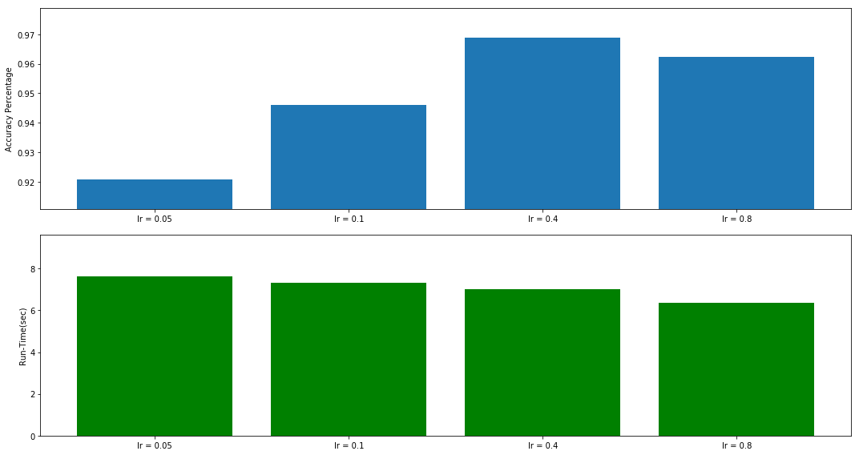
Machine learning Gradient Boosting (learning_rate)
96.8%
learning_rate=0.05, 0.1, 0.4, 0.8
n_estimators=100
max_depth=3
max_features = sqrt(n)
LAY SIT STAND WALK W-DOWN W-UP
LAY
SIT
STAND
WALK
W-DOWN
W-UP
[[571 0 0 0 0 0]
[ 1 512 41 0 0 0]
[ 0 43 522 0 0 0]
[ 0 0 0 526 1 2]
[ 0 0 0 2 408 2]
[ 0 0 1 2 1 455]]
Confusion_matrix of
learning_rate = 0.4

Slide 23
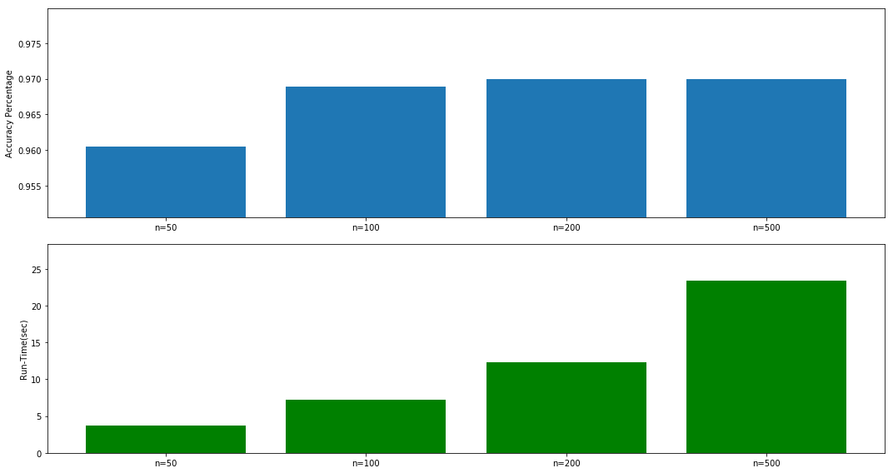
Machine learning Gradient Boosting (n_estimators)
97.0%
learning_rate= 0.4
n_estimators=50, 100, 200, 500
max_depth=3
max_features = sqrt(n)
LAY SIT STAND WALK W-DOWN W-UP
LAY
SIT
STAND
WALK
W-DOWN
W-UP
[[571 0 0 0 0 0]
[ 0 512 42 0 0 0]
[ 0 42 523 0 0 0]
[ 0 0 0 526 1 2]
[ 0 0 0 1 410 1]
[ 0 0 1 0 3 455]]
Confusion_matrix of
n_estimators = 200

Slide 24
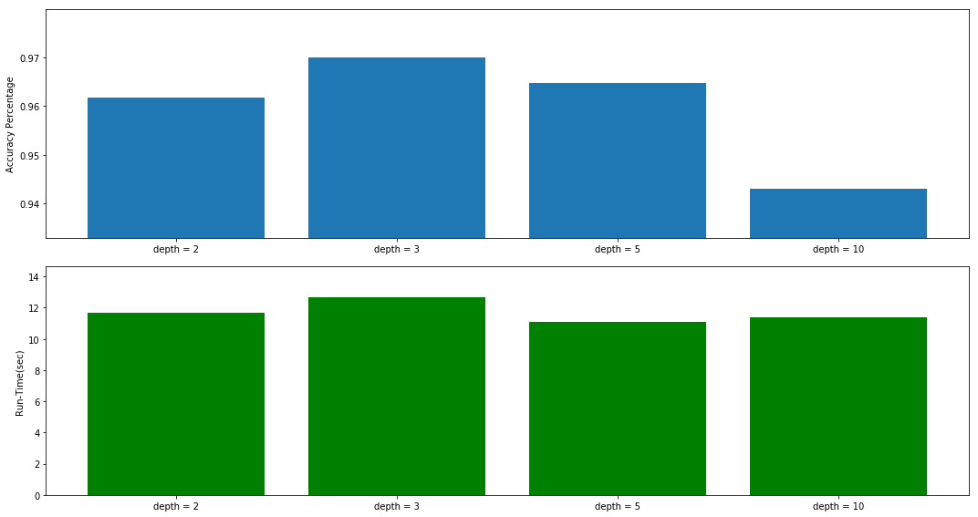
Machine learning Gradient Boosting (max_depth)
97.0%
learning_rate=0.4
n_estimators=200
max_depth=2, 3, 5, 10
max_features = sqrt(n)
LAY SIT STAND WALK W-DOWN W-UP
LAY
SIT
STAND
WALK
W-DOWN
W-UP
[[571 0 0 0 0 0]
[ 0 512 42 0 0 0]
[ 0 42 523 0 0 0]
[ 0 0 0 526 1 2]
[ 0 0 0 1 410 1]
[ 0 0 1 0 3 455]]
Confusion_matrix of
max_depth = 3

Slide 25
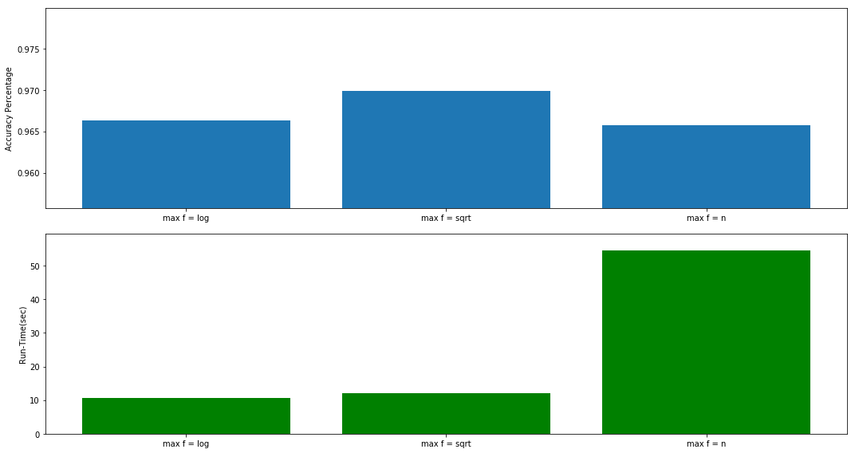
Machine learning Gradient Boosting (max_features)
97.0%
learning_rate=0.4
n_estimators=200
max_depth=3
max_features = log2, sqrt(n), None
LAY SIT STAND WALK W-DOWN W-UP
LAY
SIT
STAND
WALK
W-DOWN
W-UP
[[571 0 0 0 0 0]
[ 0 512 42 0 0 0]
[ 0 42 523 0 0 0]
[ 0 0 0 526 1 2]
[ 0 0 0 1 410 1]
[ 0 0 1 0 3 455]]
Confusion_matrix of
max_features = sqrt

Slide 26
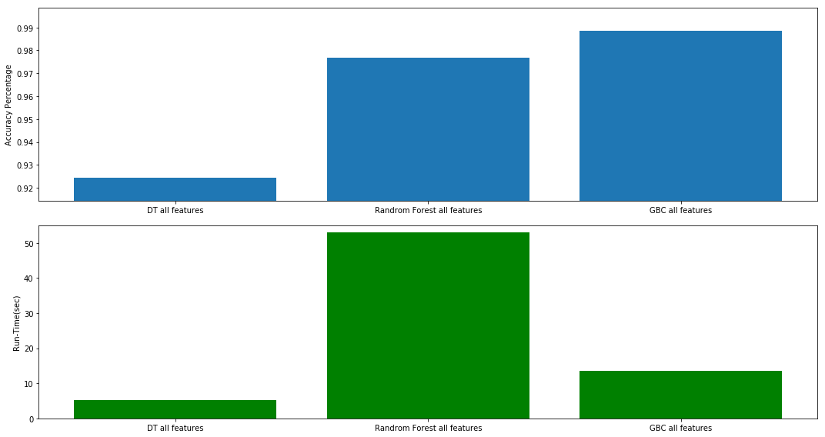
Machine learning Feature Selection (with all features)
98.9%
LAY SIT STAND WALK W-DOWN W-UP
LAY
SIT
STAND
WALK
W-DOWN
W-UP
[[571 0 0 0 0 0]
[ 0 539 15 0 0 0]
[ 0 14 551 0 0 0]
[ 0 0 0 527 1 1]
[ 0 0 0 0 408 4]
[ 0 0 0 0 0 459]]
561 features
Confusion_matrix of
GBC

Slide 27
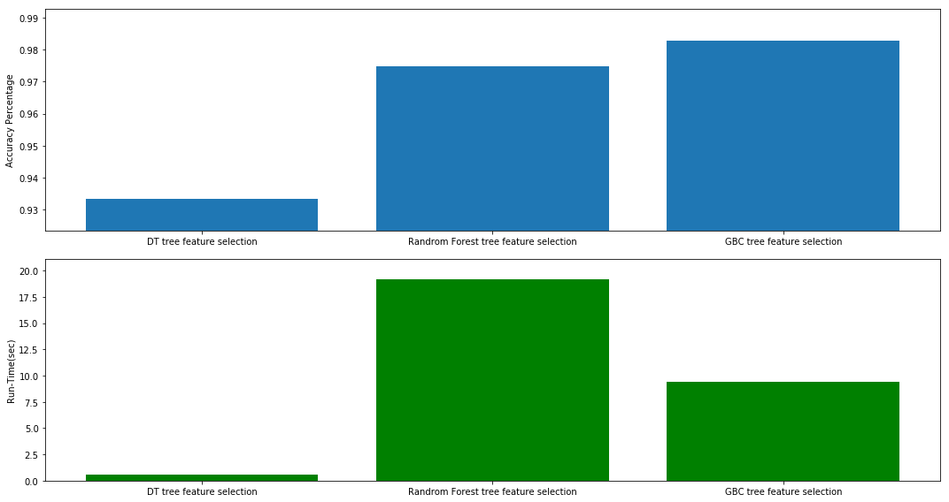
Machine learning Feature Selection (Tree-based selection)
98.3%
LAY SIT STAND WALK W-DOWN W-UP
LAY
SIT
STAND
WALK
W-DOWN
W-UP
[[571 0 0 0 0 0]
[ 0 533 21 0 0 0]
[ 0 18 547 0 0 0]
[ 0 0 0 522 3 4]
[ 0 0 0 3 406 3]
[ 0 0 0 0 1 458]]
86 features
Confusion_matrix of
GBC

Slide 28
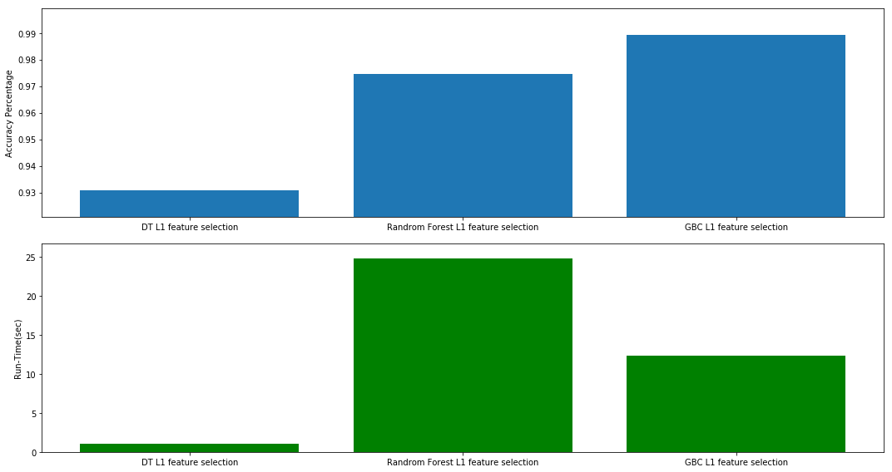
Machine learning Feature Selection (L1-based selection)
98.9%
LAY SIT STAND WALK W-DOWN W-UP
LAY
SIT
STAND
WALK
W-DOWN
W-UP
[[571 0 0 0 0 0]
[ 0 540 14 0 0 0]
[ 0 13 552 0 0 0]
[ 0 0 0 525 1 3]
[ 0 0 0 1 410 1]
[ 0 0 0 0 0 459]]
126 features
Confusion_matrix of
GBC

Slide 29
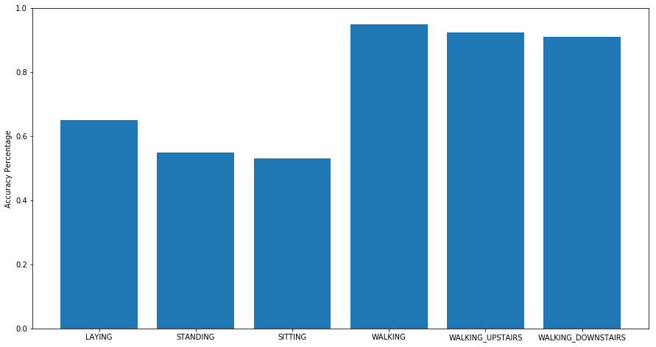
Machine learning Predicting subject
Algorithm: LGBMClassifier
n_estimators=500

Slide 30
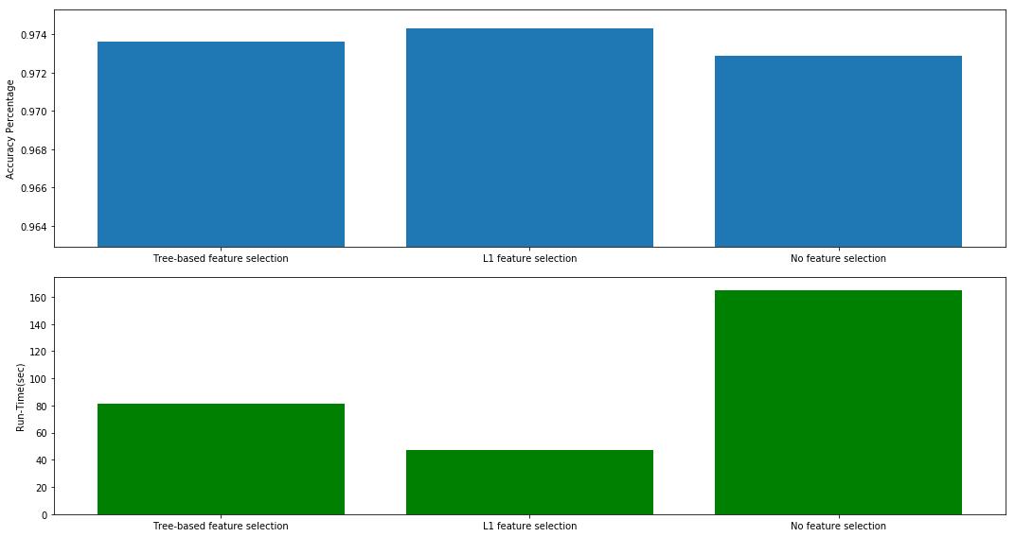
Machine learning Predicting subject (feature selection)
Algorithm: LGBMClassifier
Using all active movement data
97.4%
Tree-based: 199 features
L1-based: 158 features
No selection: 561 features
After grid search, accuracy achieved 97.8%

Slide 31
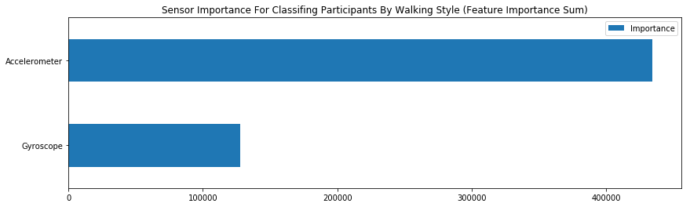
Machine learning Predicting subject (sensor importance)
Algorithm: LGBMClassifier
Take advantage of feature_importance_, grouped by keyword “Acc = accelerometer” and “Gyro = gyroscope”
n_estimators=1000
random_state=101
learning_rate=0.02
min_data_in_leaf=100
max_depth=10

Slide 32
Summary
Feature Selection:
L1-based feature selection yields highest accuracy for all models and cost less than 50% of the run-time for no feature selection.
Tree-based feature selection works almost as good as L1-based, and better than PCA (to 120 features)
Feature selection doesn’t seem to effect run-time of GBC as much.
Model performance:
Decision Tree highest accuracy 93.2% for predicting activity
Random Forest highest accuracy 97.7% for predicting activity
Gradient boosting highest accuracy 98.9% for predicting activity
LightGBM yields 97.8% accuracy for predicting participants based on walking style.
Weakness:
For all models, most error comes from differentiating standing and sitting
More algorithms to compare

